Slide 1
Train station proximity finder semester 1, 2016
James Ormond Fethers
Nijole Makovskaja
Vlad Mihai Rosca
Mark Thomas Takacs
Notes:
James

Slide 2
Scope
Introduction
Problem Statement
Methodology
Research Questions
Data Selection
Technologies
Network Analysis
Remote Group Work
TSPF Application
How developed
Strengths and Limitations
Future Directions
Notes:
James

Slide 3
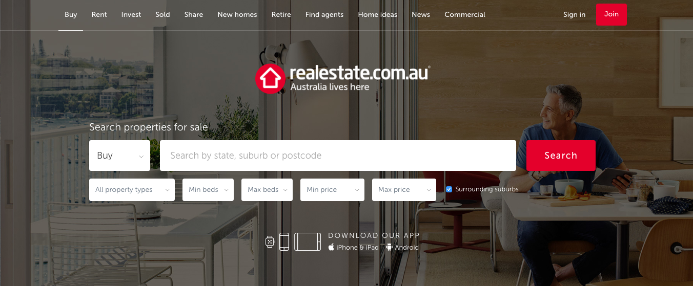
Introduction
Notes:
James This is a typical property search portal which provides traditional search criteria for searching for a property. (point out features)
We believe these options are insufficient in today’s society however, because they do not provide users information about the proximity of public transport.

Slide 4
Introduction
We want to help citizens find property within walking distance of train stations!
Why?
Because of:
Financial
Lifestyle and housing mobility
Environmental
Notes:
Mark

Slide 5
Problem Statement
How to develop a webGIS application that enables citizens to determine properties for sale within walking distance of train stations.
Notes:
Mark

Slide 6
Research Questions
1. Data Selection - What data and data quality could be used in the design and implementation of a web based application to determine the closest railway station to a property for sale?
2. Technologies - What technologies could be used to design and implement a spatially enabled property search engine?
3. Network Analysis - What is the best route finding method to find the nearest train station to properties for sale?
4. Remote Group Work - How to best coordinate group work while working remotely?
Notes:
Mark

Slide 7
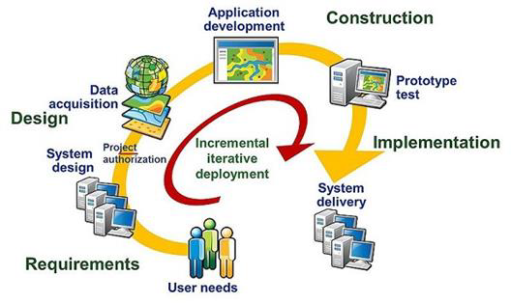
Methodology
Notes:
James
System Architecture Design is a process developed by Esri to facilitate the development of GIS solutions. It defines several critical stages to determine existing and projected user needs, and hardware and network solutions.
Although this process represents ‘best practice’ for system design, certain stages are exceptionally complex and very cumbersome to use for even a skilled and accomplished GIS professional’ and therefore we considered aspects of this process outside the scope of our project. Instead the structure of the Esri SAD was used as a framework and the process was re-defined to suit the scope of our project, which was to construct a GIS prototype operating on a local system.
For the requirements stage only user needs were considered, as system requirements were considered outside of scope because this application is only a prototype running on a local system.
During the design phase, hardware, software and network requirements were identified, and data was acquired.
During the Construction and Implementation phases the prototype was developed using Agile Methodology, with a series of versions that introduced successive improvements in functionality. All software is open source, primarily due to budget constraints, however open source software also meets the scope for the project.
I will now present only the Requirements and Design phases, as the the Construction and Implementation phases are detailed in the presentation of the application later in the presentation.
(eg. determining user needs requires determining peak usage through number of users and the location of users, bandwidth of their internet connection, etc) ‘the ESRI recommended preparatory course represents significant time and expense (3-days and $1605)’ (GeoNet, 2016),
Initially requirements are defined, which are based on user needs and the anticipated system design requirements to meet these needs.
System design is then developed, based on anticipated infrastructure upgrade requirements, network communication requirements, hardware and software procurement requirements, and anticipated data requirements. Typically, at this stage of a project, business decisions based on funding and procurement are required to proceed to the next step, the construction phase.
During the construction phase data acquisition and database design commences, as well as prototype testing and determination of delivery targets.
The final stage is implementation, where the system is delivered and the training and maintenance cycles commence.
Thin vs thick client (server side vs client side data processing) (thin clients are usually used as they have significant speed advantages as only rendered images are communicated)

Slide 8
Methodology: Requirements
User characteristics:
Home buyers or renters
Frequent users of public transport
In lower income brackets
Employed rather than unemployed
Less reliant on a motor vehicle for transport
Value a ecological and environmental friendly lifestyle
Notes:
Requirements: analyse user requirements, what technological platform can provide this service
The first step was to determine the system requirements. To achieve this the user was first identified, and then
Based on group discussions and literature reviews, it was hypothesised the user had the following characteristics:
Home buyers or renters;
Frequently use public transport;
Possibly in lower income brackets, as the cost savings associated with public transport are more appealing;
Likely to be employed rather than unemployed, as employment provides income to acquire a property and public transport can reduce commute times to work;
Younger demographics were hypothesised to walk further to public transport than older;
Less likely to be reliant on a motor vehicle for transport; and,
Assist for ecological and environmental friendly lifestyle.

Slide 9
Methodology: Requirements
User needs:
Determine the nearest train station to a property of interest, including travel time by walking
Access information about the nearest train station, such as the number of train lines
Access to the application through an existing real estate website
Process requests quickly
Intuitive
Notes:
Based on this assessment, the following user needs were hypothesised:
Determine the nearest train station to a property of interest, including travel time by walking;
Access information about the nearest train station, such as the number of train lines;
Access to the application through an existing real estate website;
Process requests quickly;
Intuitive (ensure it requires no background knowledge and information is obvious) to ensure wide uptake

Slide 10
Methodology: Requirements
Technological platform:
Function as a web GIS application in a web browser
Be available as an extension to an existing real estate web page
Be intuitive to use:
Zoom in/out
Pan
Layer switcher
Clear formatting
Notes:
To service these needs, it was determined the application shall have the following functionality:
Function as a web GIS application in a web browser, as the majority of users are not expected to have advanced computer skills;
Be available as an extension to an existing real estate web page, to be convenient and accessible;
Be intuitive to use, therefore consist of basic functions such as:
Zoom in/out
Pan
Layer switcher
Consist of clear formatting – to promote uptake to as wide an audience as possible

Slide 11
Methodology: Design
Spatial database - PostgreSQL
GIS Server – GeoServer
Web Server – N/A
Javascript based web application – OpenLayers or Leaflet
Notes:
Design: design the system architecture, select components, preliminary testing
PostgreSQL was selected as the spatial database for all versions, as was GeoServer as the GIS server, with SLD (Styled Layer Descriptor) XML based mark-up language for data styling. To display data in a web page, HTML language containing JavaScript was used. The base map is from OpenStreetMap for version I and II, and Leaflet for version III. A web server was not selected because the application prototype is only intended for a local host, however should the application be accessible on the internet, a web server would be utilised.

Slide 12
Research Question: Data Selection
OGD
Open Government Data
VGI
Volunteered Geographic Information
PPGIS
Public Participatory Geographic Information System
Notes:
Nijole
Open Government Data (OGD) Public participatory geographic information systems/science (PPGIS) and Volunteered geographic information (VGI) have emerged as important data contributors over the past decade

Slide 13
Research Question: Data Selection
Used, reused and redistributed
Taxpayer funded
Most reliable data source
INSPIRE
OGD
Notes:
Nijole
OGD is open data which can be used, reused and redistributed. Production is taxpayer funded and does not follow traditional principle, where profit is gained by selling data. But the benefit of this method is much bigger. Residents and government can communicate more effectively with open data. It helps to save unnecessary costs. More over it is the most reliable data source. This project with open data initiatives comes from INSPIRE program.

Slide 14
Research Question: Data Selection
User-generated
Spatially enabled society
OpenStreetMap, GoogleMap, Flickr
VGI
Notes:
VGI is user-generated content that has increased significantly with GPS enabled mobile phones and car navigation systems.
Users contribute georeferenced material on a voluntary basis, with the incentive to make a contribution that benefits society through spatial enablement. The success of OpenStreetMaps and Google Maps highlight the demand for such services in the private and public sectors.

Slide 15
Research Question: Data Selection
Citizen participation
Encourage positive social change
Stimulates innovation
PPGIS
Notes:
PPGIS is a web based GIS service where citizens participate in data collection and legally binding policy creation alongside government. The concept started in poor areas and developing countries, where indigenous and local leaders were consulted to extract their knowledge. It is a bottom up process to collect data, and top down to disseminate it.

Slide 16
Research Question: Data Selection
Sales data – www.domain.com.au
Street, Railway stations, Railway lines – OpenStreetMap
Cadastral database, suburb boundaries – Australian Government
Notes:
Our data is taken from…

Slide 17
Research Question: Technologies
Technologies - What technologies could be used to design and implement
a spatially enabled property search engine?
Preparing Data
Storing Data
Serving Data
Displaying Data
Notes:
Mike

Slide 18
Preparing Data
Storing Data
Serving Data
Displaying Data
Notes:
Mike

Slide 19
Preparing Data
Desktop GIS used to filter and manipulate data
Commercial and Open Source
ArcMap and QGIS
Notes:
Mike

Slide 20
Preparing Data
Storing Data
Serving Data
Displaying Data
Notes:
Mike

Slide 21
Storing Data
Spatial Database is required
Commercial and Open Source
PostgreSQL with PostGIS extension
Notes:
Mike

Slide 22
Preparing Data
Storing Data
Serving Data
Displaying Data
Notes:
Mike

Slide 23
Serving Data
Web application hosted on a local machine
GIS Server for WMS
Connecting database to final application
Notes:
Mike

Slide 24
Preparing Data
Storing Data
Serving Data
Displaying Data
Notes:
Mike

Slide 25
Displaying Data
Web application allows for user interaction
Mapping library to display data
OpenLayers and Leaflet
Notes:
Mike

Slide 26
Research Question: Technologies
What did we select and why?
QGIS and ArcMap
PostgreSQL + PostGIS
Geoserver
Simple PHP script and built-in web server
Openlayers and Leaflet
Notes:
Mike

Slide 27
Research Question: Network Analysis
Theory
Used to calculate the best route between two points
Raster or vector data
May be expressed as physical distance or cost distance
Dijkstra’s algorithm vs Contraction hierarchies
Eg. pgRouting, Open Source Routing Machine (OSRM)
Notes:
James
(1)Network analysis is used to calculate the best route between two points, and may be expressed as physical distance or cost distance (Chang, 2008). Is conducted using software acting as an extension to a postGIS database, such as pgRouting or ArcGIS.
(2)The analysis may be conducted on raster or vector data, (3) with both types capable of determining a best route by minimising cost or shortest Euclidian distance, however only vector analysis is able to determining the shortest distance for a journey on an existing network. Raster analysis generates results faster than vector analysis, but is not capable of providing true shapes of routes or route directions. The choice of Raster or Vector data depends on 1. the speed required of the analysis (raster faster than vector) 2. whether route directions are required
(4) Different applications are available to conduct routing analysis, such as pgRouting or OSRM. The main difference between them is the algorithm which they use – Dijkstras Algorithm or Contraction Hierarchies.
These algorithms are outlined in the report so I will not go into detail, however the contraction hierarchies performs pre-processing of data and Dijkstras does not, which introduces a tradeoff btw speed and flexibility.
pgRouting – uses Dijkstra’s algorithm
OSRM – uses Contraction hierarchies- a technique to speed up shortest path routing by first creating precomputed "contracted" versions of the connection graph. Contraction hierarchies can be used to generate shortest-path routes much more efficiently than Dijkstra's algorithm and is used in many advanced routing techniques.
- Dijkstras - the first stage of Dijkstra’s algorithm cells adjacent to the source cell are activated, and the cost distance measure is calculated. The cell with the lowest cost distance is selected, and its value is assigned to the output raster. This process repeats, however each time a cell is reactivated (meaning it is accessible to the source through a different path) the accumulative cost must be recomputed. The end result is a raster output with the least accumulative cost to the source cell.

Slide 28
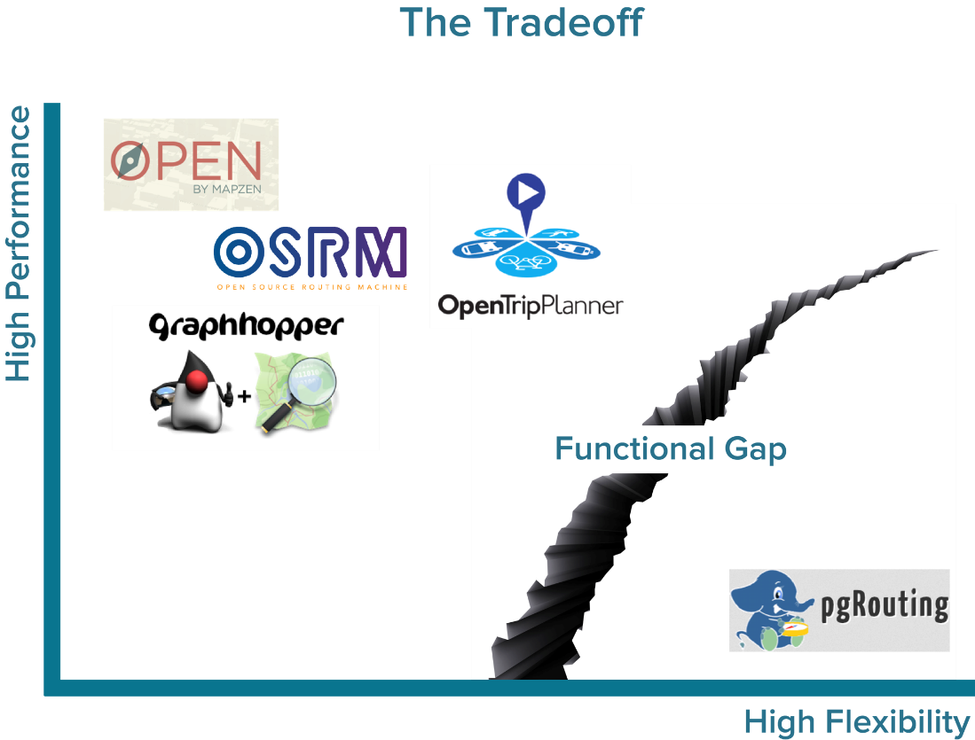
Research Question: Network Analysis
Source: www.boundlessgeo.com
Notes:
Displayed is graph demonstrating the functional gap between applications that use contraction hierarchies and dijkstras algorithm.
It illustrates the applications that use Contraction Hierarchies have increased performance in their routing solutions, however the focus on performance results in the use of fixed data models with little or no tools for adding custom data.
pgRouting stands out as an outlier. pgRouting is the only tool with an emphasis on data flexibility instead of performance. It’s network solution takes into account custom data at the moment of the query without the need for pre-processing.
The difference between the performance-focused software and pgRouting’s focus on data flexibility means there is a functional gap between the two. In order to fulfill the needs of users who want high performing routing solutions that work with their own street network data, custom development and software integration is required.
Given our application does not use live traffic data, and real estate sales data is updated sporadically, routing will remain relatively constant and therefore suitable for pre-processing. Therefore OSRM was selected.

Slide 29
Research Question: Network Analysis
What did we select?
OSRM for final version
Why?
Fast performance
Simple to implement
Notes:
James

Slide 30






Research Question: Remote Group Work
Theory
Communication
Report writing
File sharing
Project management
Notes:
Mark

Slide 31
Research Question: Remote Group Work
What did we select?
Skype or Facebook messenger (Video Chat)
Google Docs (shared Document)
File Sharing (Dropbox or google drive)
Microsoft OneNote.
Why?
Skype
Google Docs
Microsoft one note.
Notes:
Mark
This project was the collaboration of four individuals working in different time zones around the world for much of the project. At the commencement, physical meetings with the group and project supervisor occurred on a regular basis, and then online meetings were conducted approximately every week and whenever deemed necessary once group members separated.
Skype proved a very effective method to conduct group meetings overall, due to the generally high voice quality and free access.
Google Docs proved a useful platform to draft the report, however several limitations were noted. It was useful because it is free to use, compatible with multiple web browsers, and updates in real time.
Drop box , More Familiar with drop box.
Microsoft OneNote was a highly suitable platform for sharing ideas, creating task lists, and recording meeting minutes. It updated information in real time and provided extremely versatile formatting. It was free to use and operated on all operating systems.

Slide 32
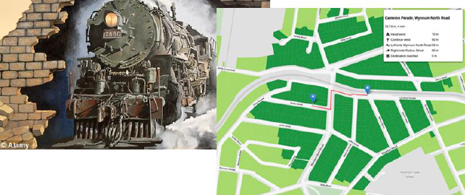
TSPF Application
Notes:
Nijole
Train Station Proximity Finder Application
The aim of this report is to develop a webGIS application that enables citizens to determine properties for sale within walking distance of train stations.

Slide 33
TSPF: Development
How did we create this application?
Version 1 – Simple representation of data (4 Train stations, Sales, Cadastral).
Version 2 – Euclidian Buffer Zones (calculated on walking speed of 5km/h).
Version 3 – Isochrones (GRASS), Data filtering and preparation.
Version 4 – The final application with routing
Notes:
Nijole
The versions was made by Agile methodology. We create 4 versions.
Version 1 - is representing the data,
Version 2 – showing buffers within different distance.
Version 3 – presenting isochrones map, this time walking distance is counted with real walking pats
Version 4 – provides routing functionality

Slide 34
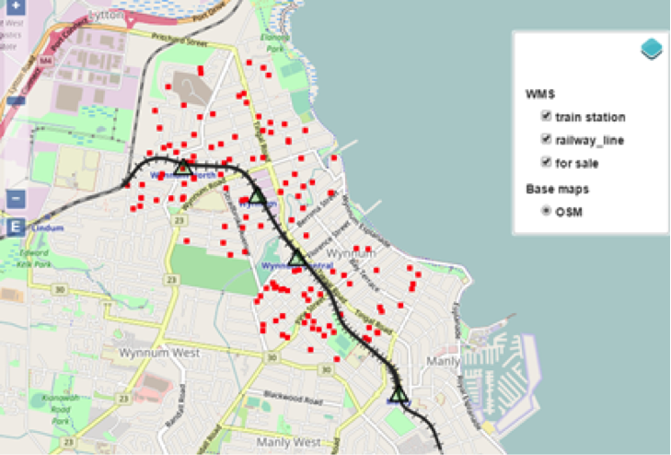
Version 1
Notes:
James/ Nijole
Version 1 is a basic webGIS application which serves as a proof of concept and validates the data.
3 different data sets are displayed:
- Train Stations
- Railway lines
- Properties for sale
Spatial data for train stations and railway lines was relatively simple to acquire. It was exported from OpenStreetMap in .OSM format, and then converted to shapefiles via Global Mapper (used on a trial account. QGIS could have been used also).
Property data however was a little more complex. The dataset of properties for sale was exported from the Australian real estate website domain.com.au in .csv format, and contained only address data. This data was converted to .shp files using a 2 step process. Firstly

Slide 35
Version 1
Spatial Database
PostgreSQL
GIS Server
GeoServer
Web Server
N/A – local host
Javascript based Web Application
OpenLayers
Notes:
PostgreSQL –
GeoServer -
OpenLayers - OpenLayers is an open source (provided under the 2-clause BSD License^{[2]}) JavaScript library for displaying map data in web browsers as slippy maps. It provides an API for building rich web-based geographic applications similar to Google Maps and Bing Maps.

Slide 36
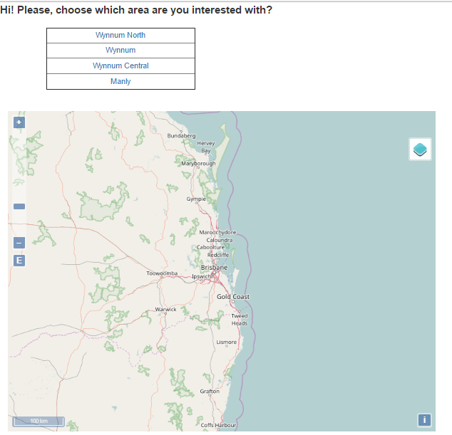
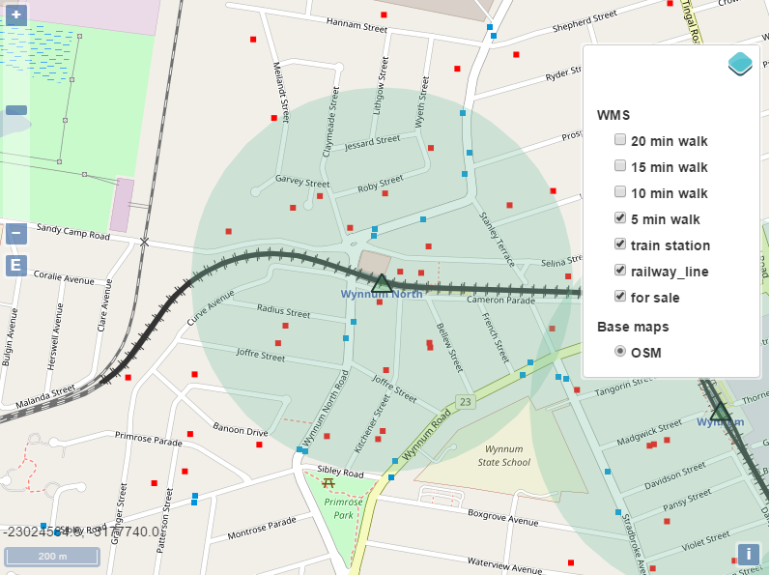
Version 2
Notes:
James/ Nijole
Here we adding more user friendly interface with 4 train stations options, which user can choose. And proximity buffer zones. Here you see, that train station Wynnum North was selected and the distance which is on interest is 5 min.
Because it's only the 2nd version and we are working with Agile (testing-developing) methodology, we have to determine weakness of the version, some of them are:
proximity is shown of all train stations
Train stations are only 4, so they can be made as a buttons, but if there will be more, than it should be changed by cascade list
Buffer zones are not precise, because they aren't following specific walking path

Slide 37
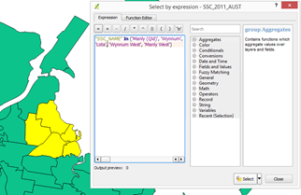
Version 3
Dataset | Provider | Usage
Streets | Openstreetmap (Mapzen) | Creation of Isochrones
Digital Cadastral Database (DCDB) | Queensland Government Spatial Catalogue | Creation and Display of Isochrones
Railway Stations | Queensland Government Spatial Catalogue | Display of Railway Stations
Suburb Boundaries | Australian Bureau of Statistics | Data filtering and preparation
Notes:
Improves Functionality of application, essentially the foundation for version 4.
Introduces OSM roads data obtained from Mapzen.
Roads, railways stations, suburb boundaries and cadastral data prepared using QGIS not arc map, due to lack of licence.

Slide 38
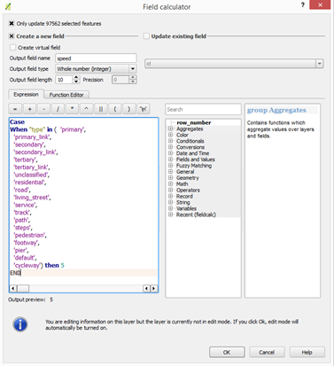
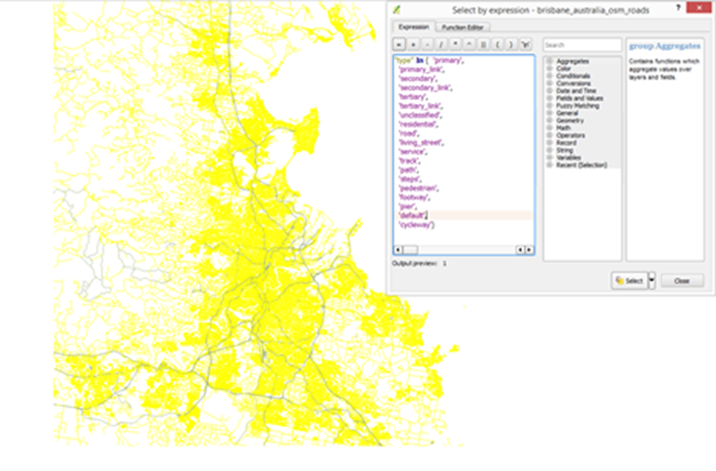
Version 3
Notes:
OSRM Backend walking profile from Github used to select all walkable roads. Excluding Highways, dirt tracks etc.
Walkable roads.shp assigned speeds of 5km/hr and

Slide 39
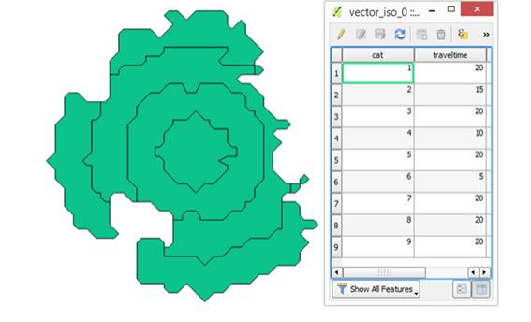
Version 3
Notes:
Mark.
Walkable roads.shp inputted into GRASS GIS with each specific train station to generate a isochrone map,
Which then is exported into QGIS and used to create cadastral layers which are defined by walking distances of 5, 10 ,15 and 20 minutes.
Isochrones styled to adequately display different walking times and presented as WMS using leaflet.

Slide 40
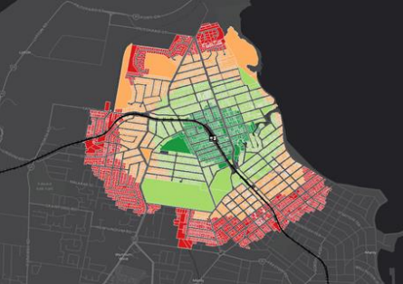
Version 3
Notes:
Mark.
Isochrones styled to adequately display different walking times and presented on leaflet as a WMS.
SLD cookbook attribute based polygon based on distance.

Slide 41
Final Application
The final application provides the majority of the functionality that we have set out to implement at the beginning of the project.
Which is an application that locates houses for sale within a chosen walking distance of a selected train station.
Demo
Notes:
Mike

Slide 42
TSPF: Strengths and Limitations
Weaknesses :
The current search options are limited to searching by location (e.g. suburb or city) rather than location relative to other points of interest.
no live sales data, hyper localized, and is only focused on train stations
No information about train stations (eg. Timetables)
Strengths:
Innovative, New technology.
Our application aims to fill a gap in the market by providing alternative search capabilities to the traditional property search options.
Notes:
Mark

Slide 43
TSPF: Future Directions
Future version would prove to be faster, more visually appealing and more user friendly.
In order to rectify aforementioned limitations , a number of improvements are suggested:
integration of live sales data through a property sales portal API,
inclusion of a larger area of interest e.g. the entire city of Brisbane,
the option for users to search relative to other points of interest, such as schools, hospitals or supermarkets.
Notes:
Nijole

Slide 44
Questions?
Notes:
James

